Slide 1
MS-601
Managing in a Global Environment

Slide 2
Learning Objectives
4.1 Contrast various attitudes toward global business.
4.2 Discuss the importance of regional trading alliances and global trade mechanisms.
4.3 Describe the structures and techniques organizations use as they go international.
4.4 Explain the relevance of the political/legal, economic, and cultural environments to global business.

Slide 3
Global Attitudes and Perspectives
Parochialism: viewing the world solely through your own perspectives, leading to an inability to recognize differences between people
Ethnocentric: view that home country has best work practices
Polycentric: view that managers in the host country know the best approaches
Geocentric: world-oriented view; wants to use best practices from around the globe
Notes:
First, an ethnocentric attitude is the belief that the best work approaches and practices are those of the home country (the country in which the company’s parochialistic headquarters are located). Managers with an ethnocentric attitude believe that people in foreign countries don’t have the needed skills, expertise, knowledge, or experience to make the best business decisions as people in the home country do.
A polycentric attitude is the view that employees in the host country (the foreign country in which the organization is doing business) know the best work approaches and practices for running their business. Managers with this attitude view every foreign operation as different and hard to understand. Thus, they’re likely to let employees there figure out how best to do things.
A geocentric attitude is a world-oriented view that focuses on using the best approaches and people from around the globe. Managers with this type of attitude have a global view and look for the best approaches and people regardless of origin.

Slide 4
Regional Trading Alliances
These are agreements between countries to lower trade barriers, align economic policies, and strengthen their collective economic power
European Union (EU): a union of 27 democratic European nations (United Kingdom exist known as Brexit) with Euro as the official currency
United States–Mexico–Canada Agreement (USMCA) (previously existed as North American Free Trade Agreement, NAFTA): an updated agreement among the Mexican, Canadian, and U.S. governments to eliminate trade barriers and strengthen economic power
Association of Southeast Asian Nations (ASEAN): a trading alliance of 10 Southeast Asian nations promoting economic growth, social progress, and regional stability among its member nations
Notes:
The European Union (EU) is an economic and political partnership of 28 democratic European countries. Eight countries (Croatia, the former Yugoslav Republic of Macedonia, Turkey, Albania, Bosnia-Herzegovina, Iceland, Montenegro, and Serbia) are candidates to join the EU.
When the 12 original members formed the EU in 1992, the primary motivation was to reassert the region’s economic position against the United States and Japan. Before then, each European nation had border controls, taxes, and subsidies; nationalistic policies; and protected industries. Now with these barriers removed, the economic power represented by the EU is considerable. Its current membership covers a population base of more than half a billion people (7 percent of the world population) and accounts for approximately 16 percent of the world’s global exports and imports.
Another step toward full unification occurred when the common European currency, the euro, was adopted. The euro is currently in use in 18 of the 28 member states, and all new member countries must adopt the euro. Only Denmark, the United Kingdom, and Sweden have been allowed to opt out of using the euro.

Slide 5
Global Trade Mechanisms
World Trade Organization (WTO): global organization of 166 countries . It regulates over 98% of all global trade and GDP.
International Monetary Fund (IMF): An organization of 191 countries that hat promotes international monetary cooperation, provides economic advice, and acts as a lender of last resort.
World Bank Group: a group of very closely associated institutions that provides financial and technical assistance to developing countries. Focuses on long-term economic development, reducing poverty, and funding infrastructure projects
Organization for Economic Cooperation and Development (OECD): an international economic organization that assists its 38 member countries with financial support and sustainable economic growth. It primarily consists of highly developed, high-income countries working to stimulate economic progress.
Notes:
The World Trade Organization (WTO) is a global organization of 161 countries (as of April 2015) that deals with the rules of trade among nations.48 Formed in 1995, the WTO evolved from the General Agreement on Tariffs and Trade (GATT), a trade agreement in effect since the end of World War II. To- day, the WTO is the only global organization that deals with trade rules among nations. Its membership consists of 161 member countries and 24 observer governments (which have a specific time frame within which they must apply to become members).
The goal of the WTO is to help countries conduct trade through a system of rules. Although critics have staged vocal protests against the WTO, claiming that global trade destroys jobs and the natural environment, it appears to play an important role in monitoring, promoting, and protecting global trade.

Slide 6
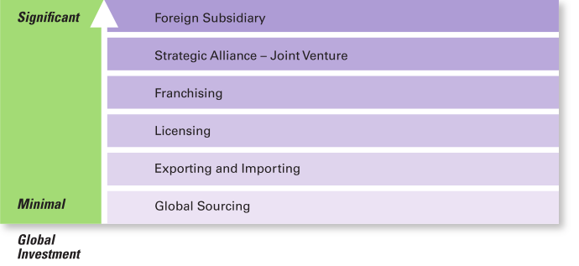
Exhibit 4-4
How Organizations Go Global
Exhibit 4-4 shows the different approaches companies can use to go global.

Slide 7
Approaches To Go Global _{(1/3)}
Global sourcing: purchasing materials or labor from around the world wherever it is cheapest
Exporting: making products domestically and selling them abroad. Example, Boing manufacturers
  Importing: acquiring products made abroad and selling them domestically. Example, Walmart
Notes:
When organizations do go international, they often use different approaches. (see Exhibit 4-4). Managers who want to get into a global market with minimal investment may start with global sourcing (also called global outsourcing), which is purchasing materials or labor from around the world wherever it is cheapest. The goal takes advantage of lower costs in order to be more competitive.
Although global sourcing may be the first step in going international for many companies, they often continue to use this approach because of the competitive advantages it offers. Each successive stage of going international beyond global sourcing, however, requires more investment and thus entails more risk for the organization.

Slide 8
Approaches To Go Global _{(2/3)}
Licensing: an organization gives another organization the right to use the company’s brand name and make or sell its products using its technology or product specifications.
Franchising: an organization gives another organization the right to use its name and operating methods.
Notes:
When organizations do go international, they often use different approaches. (see Exhibit 4-4). Managers who want to get into a global market with minimal investment may start with global sourcing (also called global outsourcing), which is purchasing materials or labor from around the world wherever it is cheapest. The goal takes advantage of lower costs in order to be more competitive.
Although global sourcing may be the first step in going international for many companies, they often continue to use this approach because of the competitive advantages it offers. Each successive stage of going international beyond global sourcing, however, requires more investment and thus entails more risk for the organization.

Slide 9
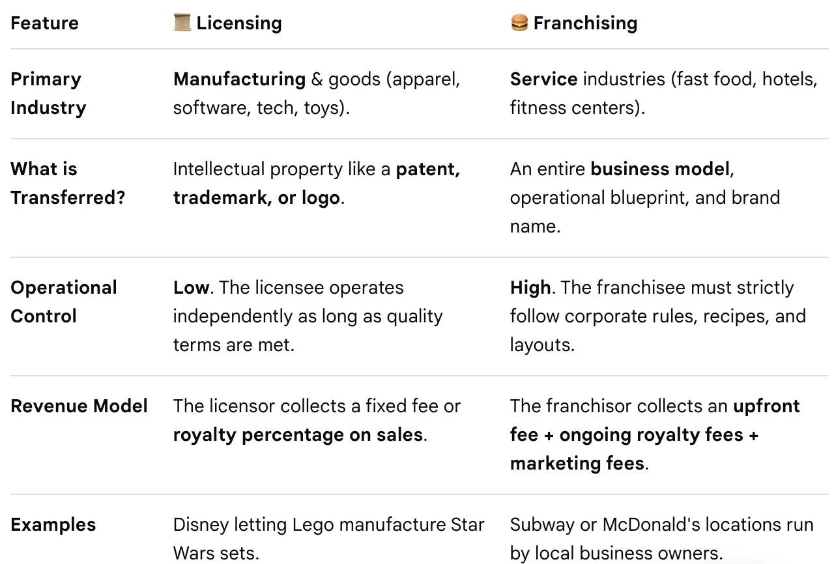

Slide 10
Approaches To Go Global _{(3/3)}
Global Strategic Alliance: partnership between an organization and foreign company partner(s) in which both share resources and knowledge in developing new products or building production facilities. Example, Starbucks and PepsiCo collaborated to sell bottled Frappuccino
  Joint Venture: A specific type of strategic alliance in which the partners agree to form a separate, independent organization for some business purpose. Example, Sony Honda Mobility
  Foreign Subsidiary: directly investing in a foreign country by setting up a separate and independent production facility or office
Notes:
When organizations do go international, they often use different approaches. (see Exhibit 4-4). Managers who want to get into a global market with minimal investment may start with global sourcing (also called global outsourcing), which is purchasing materials or labor from around the world wherever it is cheapest. The goal takes advantage of lower costs in order to be more competitive.
Although global sourcing may be the first step in going international for many companies, they often continue to use this approach because of the competitive advantages it offers. Each successive stage of going international beyond global sourcing, however, requires more investment and thus entails more risk for the organization.

Slide 11
Structures To Go International
A multinational corporation (MNC)—an international company that maintains operations in multiple countries.
A multidomestic organization (IMF)—an MNC that decentralizes management and other decisions to the local country.
A global organization—an MNC that centralizes management and other decisions in the home country.
A transnational or borderless organization—an MNC that has eliminated artificial geographical barriers.
Notes:
A multinational corporation is an international company that maintains operations in multiple countries. A multidomestic organization is an MNC that decentralizes management and other decisions to the local country (the polycentric attitude). A global organization is an MNC that centralizes management and other decisions in the home country (the ethnocentric attitude). A transnational organization (the geocentric attitude) is an MNC that has eliminated artificial geographical barriers and uses the best work practices and approaches from wherever.

Slide 12
Managing in a Global Environment
The laws and political stability of a country are issues in the global political/legal environment with which managers must be familiar
Managers must be aware of a country’s economic issues such as currency exchange rates, inflation rates, and tax policies.
Geert Hofstede identified five dimensions for assessing a country’s culture: individualism-collectivism, power distance, uncertainty avoidance, achievement-nurturing, and long-term/short-term orientation.
Notes:
The laws and political stability of a country are issues in the global political/legal environment with which managers must be familiar. Likewise, managers must be aware of a country’s economic issues such as currency exchange rates, inflation rates, and tax policies.

Slide 13
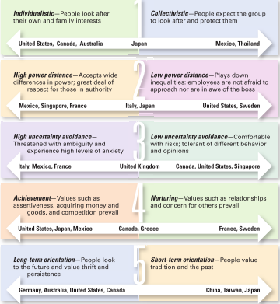
Exhibit 4-6
Hofstede’s Five Dimensions of National Culture
Exhibit 4-6 shows Hofstede’s Five Dimensions of National Culture.
Notes:
Geert Hofstede developed one of the most widely referenced approaches to helping managers better understand differences between national cultures. His research found that countries vary on five dimensions of national culture. These dimensions are described in Exhibit 4-6, which also shows some of the countries characterized by those dimensions.
Source: Based on Hofstede, Geert, Culture’s Consequences: International Differences in Work-Related Values, © Geert Hofstede, 1980 (Newbury Park: SAGE Publications, Inc., 1980).

Slide 14
Where India lies?
1. High Power Distance
2. Moderately Collectivistic (with Individualistic Traits)
3. Low to Medium Uncertainty Avoidance
4. Moderately High Achievement-Oriented (Masculine)
5. Long-Term Orientation

Slide 15
Global Leadership and Organizational Behavior Effectiveness (GLOBE)
The GLOBE studies identified nine dimensions for assessing country cultures.
Power distance
Uncertainty avoidance
Assertiveness
Humane orientation
Future orientation
Institutional collectivism
Gender differentiation
In-group collectivism
Performance orientation
Notes:
The Global Leadership and Organizational Behavior Effectiveness (GLOBE) program is an ongoing research program that extended Hofstede’s work by investigating cross-cultural leadership behaviors and giving managers additional information to help them identify and manage cultural differences. Using data from more than 18,000 managers in 62 countries, the GLOBE research team (led by Robert House) identified 9 dimensions on which national cultures differ.
Two dimensions (power distance and uncertainty avoidance) fit directly with Hofstede’s. Four are similar to Hofstede’s (assertiveness, which is similar to achievement-nurturing; humane orientation, which is similar to the nurturing dimension; future orientation, which is similar to long-term and short-term orientation; and institutional collectivism, which is similar to individualism-collectivism). The remaining three (gender differentiation, in-group collectivism, and performance orientation) offer additional insights into a country’s culture.
The GLOBE studies confirm that Hofstede’s dimensions are still valid and extend his research rather than replace it. GLOBE’s added dimensions provide an expanded and updated measure of countries’ cultural differences. It’s likely that cross-cultural studies of human behavior and organizational practices will increasingly use the GLOBE dimensions to assess differences between countries.

Slide 16
Global Management in Today’s World
Cultural Intelligence: cultural awareness and sensitivity skills
Global Mind-Set: attributes that allow a leader to be effective in cross-cultural environments
Notes:
As globalization continues to be important for businesses, it’s obvious that managers need to understand how to best manage that global workforce. Some researchers have suggested that managers need cultural intelligence or cultural awareness and sensitivity skills. Cultural intelligence encompasses three main dimensions: (1) knowledge of culture as a concept—how cultures vary and how they affect behavior; (2) mindfulness—the ability to pay attention to signals and reactions in different cross-cultural situations; and (3) behavioral skills—using one’s knowledge and mindfulness to choose appropriate behaviors in those situations.
Other researchers have said that what effective global leaders need is a global mind-set, attributes that allow a leader to be effective in cross-cultural environments.
Those attributes have three components as shown in Exhibit 4-7.

Slide 17
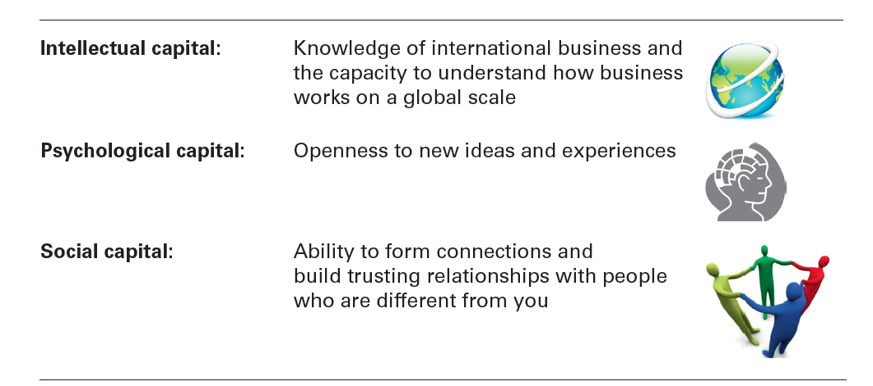
Exhibit 4-7
A Global Mind-Set
Intellectual capital: | Knowledge of international business and the capacity to understand how business works on a global scale
Psychological capital: | Openness to new ideas and experiences
Social capital: | Ability to form connections and build trusting relationships with people who are different from you
Exhibit 4-7 shows components of a global mind-set.
Notes:
Source: Based on M. Javidan, M.Teagarden, and D. Bowen, “Making It Overseas,” Harvard Business Review, April 2010, and J. McGregor, ed., “Testing Managers’ Global IQ,” Bloomberg BusinessWeek, September 28, 2009.

